Slide 1
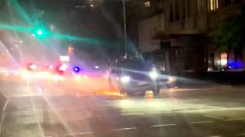
DUI - INSIDE A HIGH SPEED HOT PURSUIT
INTRODUCTION – People’s Case & Defense’s Case 15 min
DUI FORENSIC LAB WITNESS TESTIMONY 25 min
Forensic Tech Qualifications
Physical, Psychological & Scientific tests
Alcohol Impairment Study
Drink Equivalent
POLICE TESTIMONY 25 min
Physical Tests 2. Psychological Tests 3. Scientific Tests
TERMINOLOGY QUIZ 1. 20 min
Example: Nystagmus test is uncontrolled face movements of an inebriated person. True or False? _____
JURY INSTRUCTIONS 25 min
General Rules
Prosecution & Defense
CLOSING STATEMENTS – burden of proof, definitions, deadly weapon, circumstantial evidence, law and tests 25 min
TERMINOLOGY QUIZ 2. 25 min
Example: If there is a little doubt whether defendant committed a crime the verdict should be not guilty. True or false?
DISCUSSIONS 20 min

